Slide 1
BootCon 2023
Jordan McElhinney, Jeremy Knerr, Ryan Whittaker
Notes:
RYAN’S SLIDE (~30 seconds)

Slide 2
Explanation of Topic
Why Chosen: With the rise in social media platforms and heightened use, we wanted to show how Phishing schemes could be implemented that mimic those familiar portals
Concepts Applied: HTML, CSS, Scripting, Social Engineering
Research Done: Researched different phishing tools, gathered HTML basics for creation of a website
Notes:
RYAN’S SLIDE (~3 minutes)
Researched different tools to see which would fit our outline the best

Slide 3
Preview of Steps
Created a fake website link through the SocialPhish tool
Sent out the fake link to multiple company emails
Waited for a user to use the link and provide credentials
Stole credentials using the SocialPhish tool
Credentials noted in a file for later use
Notes:
RYAN’S SLIDE (~3 minutes)

Slide 4
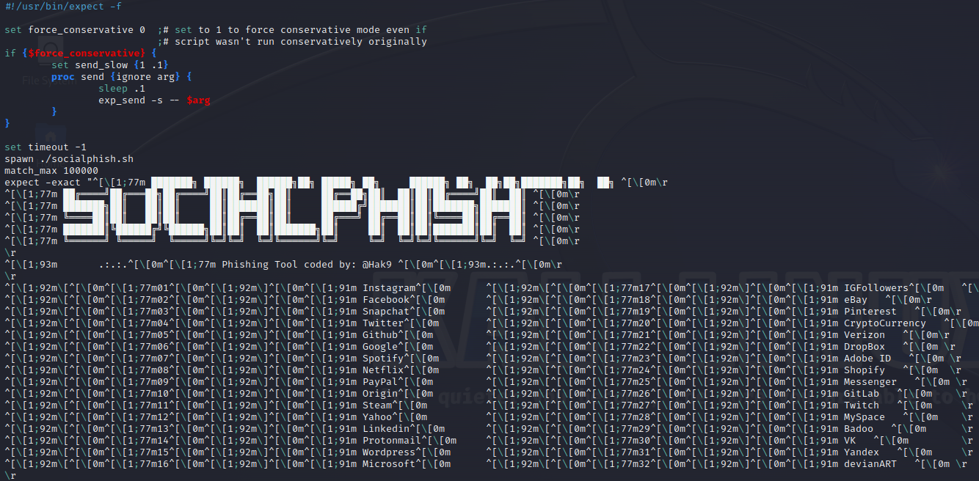
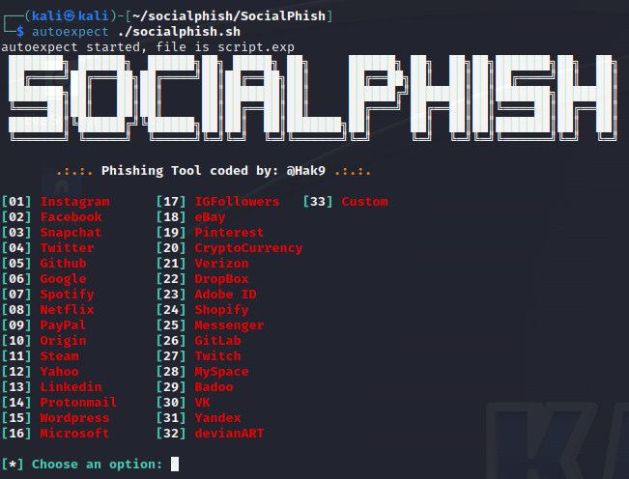
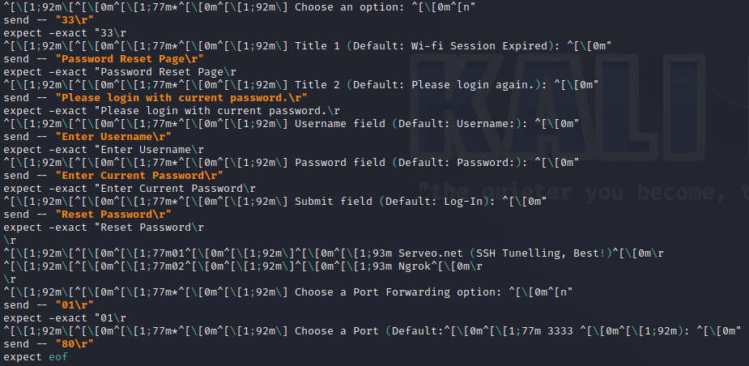
script.exp
autoexpect ./socialphish.sh
Notes:
JEREMY’S SLIDE (~1min)

Slide 5

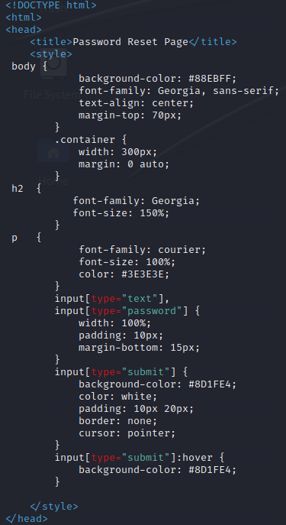
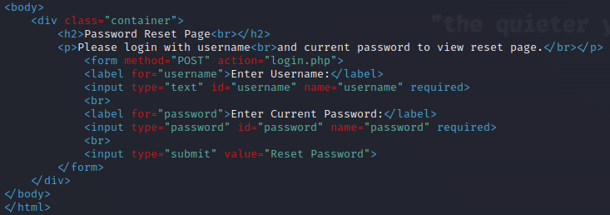
html_script.sh
login.php
login.html
Notes:
JEREMY’S SLIDE (~1min)

Slide 6

Demo Slide
Notes:
JEREMY’S SLIDE (~2 minutes)
Run script to launch fake website
Run script to replace generic html code with our custom html code
Use Emkei’s to spoof the domain and send an email (with link) from the “help desk”
Receive email on victim’s email server
Click link from email
Input credentials
Go back to machine to show credentials being saved and stored

Slide 7
Demo Summary
Utilized SocialPhish to conduct a phishing attack
Used the program to make a fake website link that is similar to a fake company’s real site
These links were sent out to company emails to see if users would enter credentials into the spoof page
Credentials were stolen and noted down in a file
Notes:
JORDAN’S SLIDE (~2 minutes)
Saves credentials to a file named saved.usernames.txt

Slide 8
Mitigation Strategies
Security awareness training
Use phishing email attempts through an in house IT team
Use email software that scans for possible fake emails
Notes:
JORDAN’S SLIDE (~3 minutes)
Have the company IT team do test phishing emails alongside possible group training to demonstrate how damaging a phishing attack can be

Slide 9
Sources
SocialPhish Repository
HTML Basics
Expect Scripts

